Slide 1
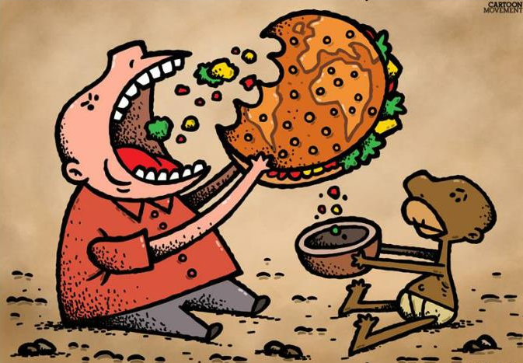


Project review: SOLITARY IDENTIFICATION OF CONSIDERATE NUTRITIONAL CONSUMPTION( i.e. IMPACTS ON skin-aging, MALNUTRITION) AND ANALYZING FACTORS SUCH AS CLIMATIC IMPACTS ON FOOD PRODUCTION USING MACHINE LEARNING AND DATA ANALYTICS
DONE BY -
ARYAN SHIV SIDDHABATHULA – B13 29
Vunamati satyanarayanA – b13 55
N Tejaswi – b13 38
M shiva ganesh – b13 54

Slide 2
ABSTRACT
The food supply chain is directly at danger from climate threats affecting the agricultural sector.
Accelerated climate variability affects every part of the food chain, including food production, food processing, retailing/distribution, and consumption. For instance, escalating heat waves, floods, droughts,and other extreme occurrences directly endanger soil health and food production, resulting in serious food-shortages. This will consequently lead to an increase in foodprices, It is also crucial to keep in mind that poorer regions of the world will likely be disproportionately affected by severe food shortages. As a result, the food system is extremely susceptible to change, particularly in an agrarian nation like India.
All kinds of malnutrition include undernutrition (wasting, stunting, and underweight), insufficient vitamins and minerals, overweight, obesity, and the ensuing noncommunicable diseases linked to diet. 462 million adults are underweight, compared to 1.9 billion who are overweight or obese. In 2020, it was anticipated that 149 million children under the age of five were stunted (too short for their age), 45 million were wasting (too short for their height), and 38.9 million were overweight or obese. Undernutrition is a contributing factor in about 45% of fatalities in children under the age of five. Most of these take place in low- and middle-income nations. The prevalence of childhood obesity and overweight is also rising in these same nations.

Slide 3

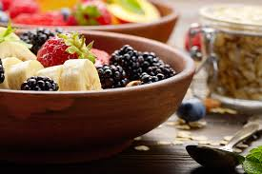
The body's main defence against external aggressions is its skin. Chronological ageing and photo-aging are two different types of skin ageing that are both influenced by internal and environmental influences. People have progressively come to understand the significance of diet, which serves as the body's primary source of energy and nutrients, for the skin. Poor eating habits and nutritional imbalances are significant contributors to skin ageing, according to modern science.
Using these three major factors as our base towards building a machine learning model to identify the reasons and causes for malnutrition among individuals.

Slide 4
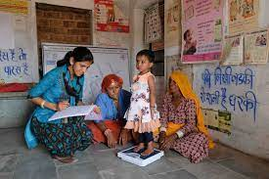
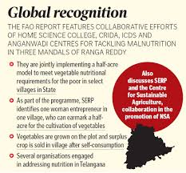
PROBLEM STATEMENT –
It may be a good idea to some extent to analyse numerous records, spot patterns and trends, and draw conclusions regarding malnutrition across the nation. However, because the reports were analysed as a whole, there may still be many individuals whose data has not been recovered and these analyses were done solely using the poverty score. We will be able to assess food and nutritional consumption through the model we created in order to anticipate malnutrition on an individual basis, making it a more precise and effective method of recognising incorrect food intake. Additionally, these findings may be helpful in a wide range of industries and areas.

Slide 5
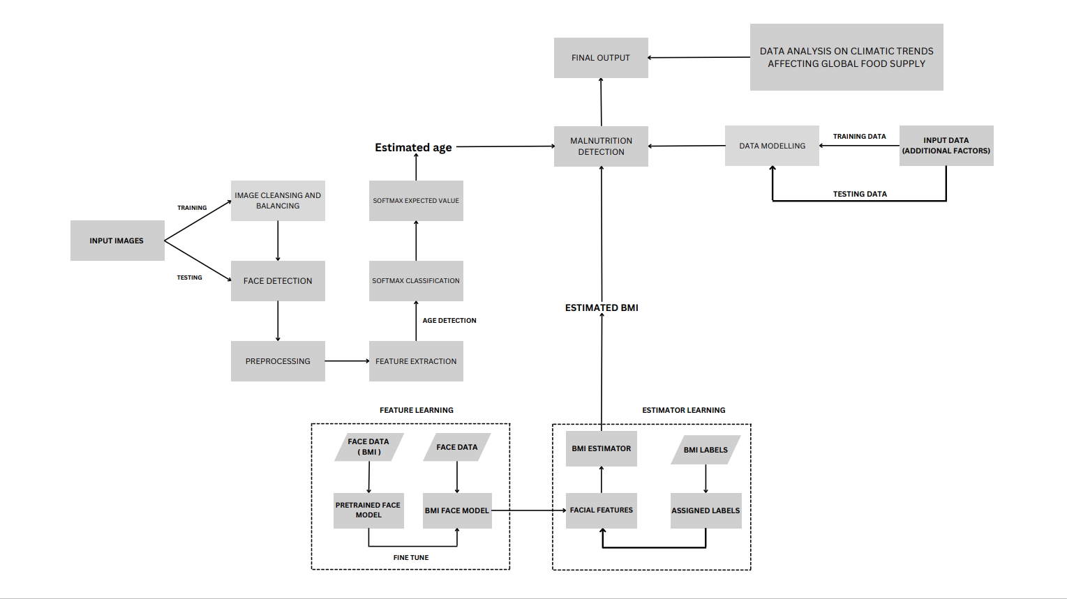

Slide 6
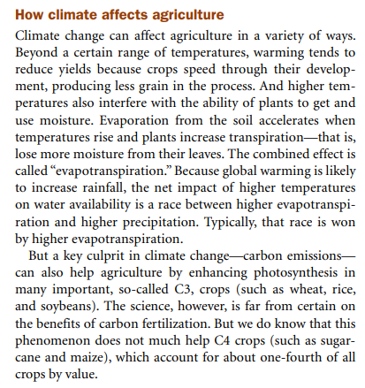
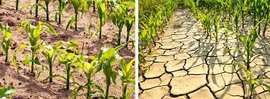
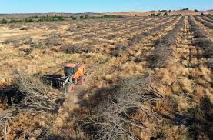
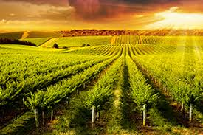
DATA ANALYSIS OF CLIMATIC IMPACTS UPON CROP PRODUCTION ACROSS VARIOUS COUNTRIES

Slide 7
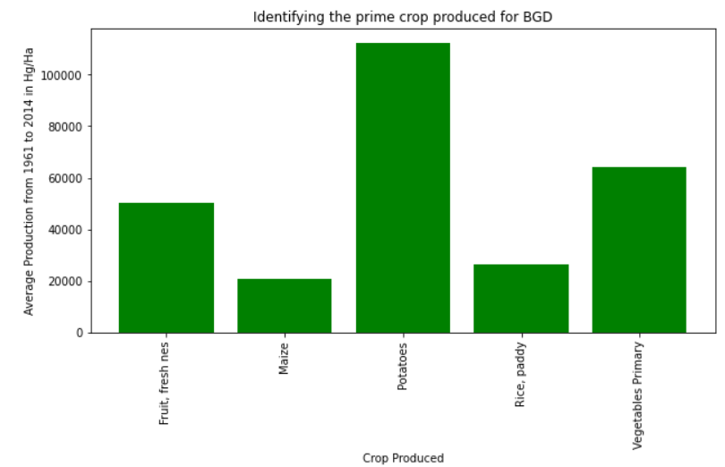
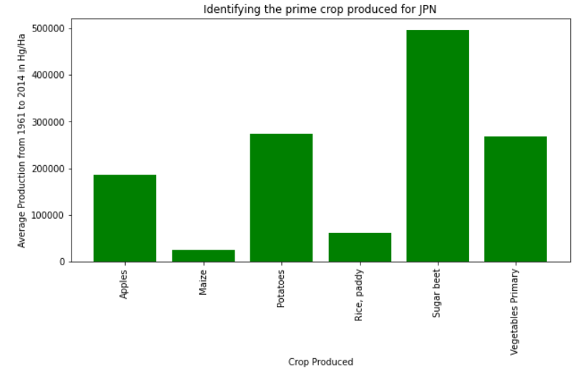
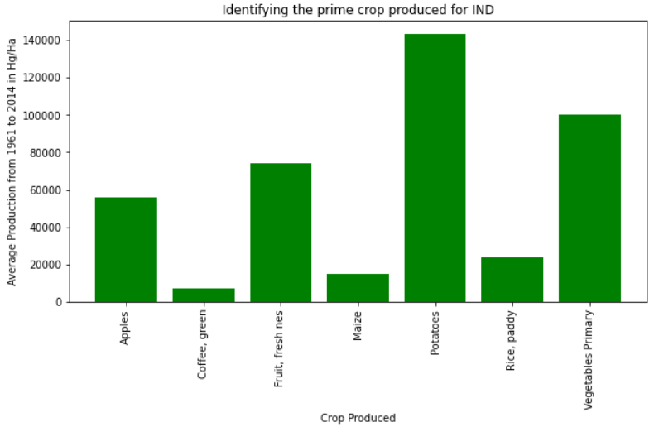
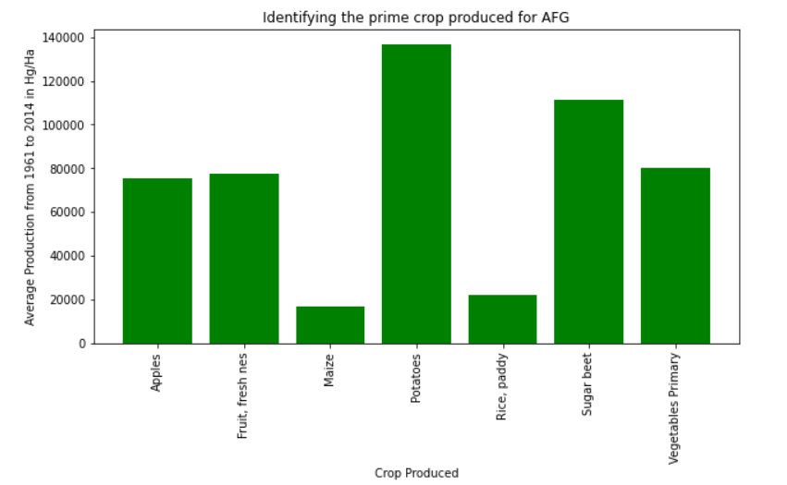
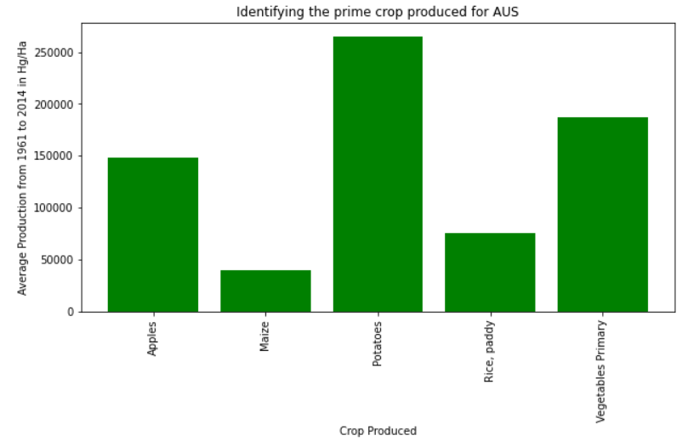
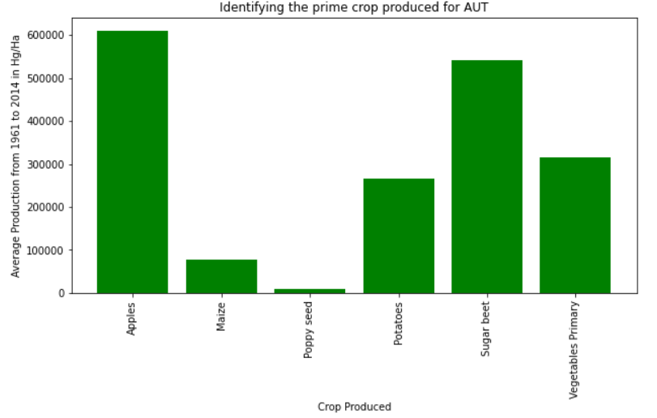
PRIME CROPS ACROSS COUNTRIES
Below are the graphical representation of different crops and their production for limited number of countries

Slide 8
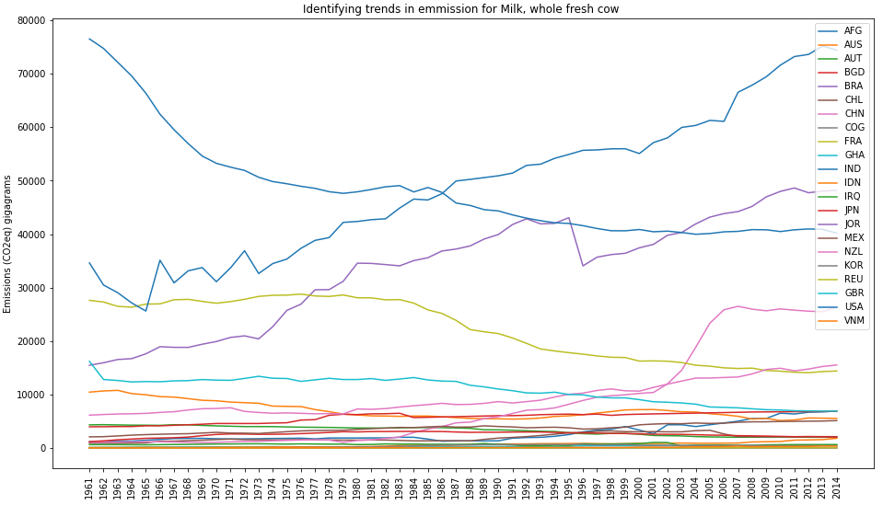
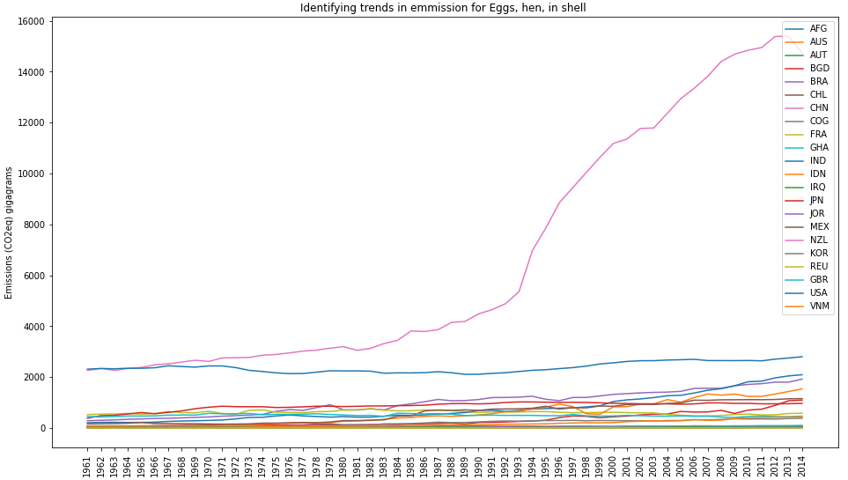
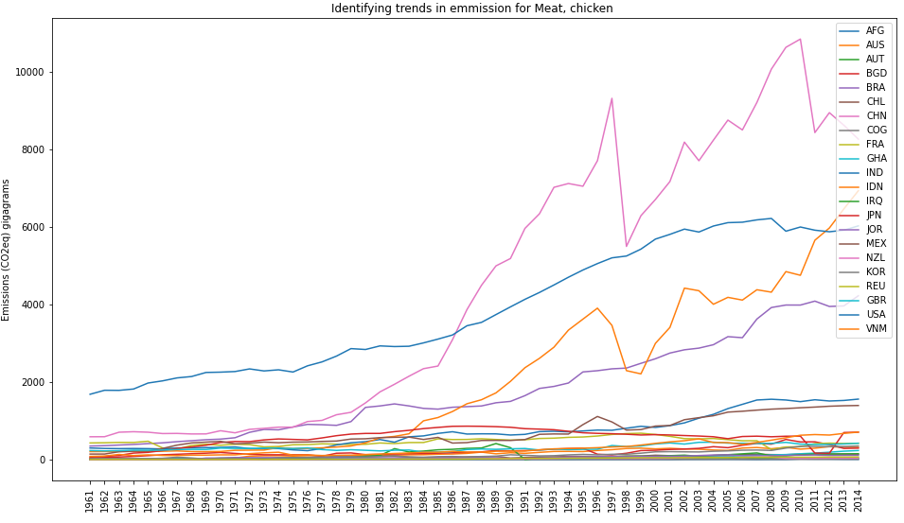
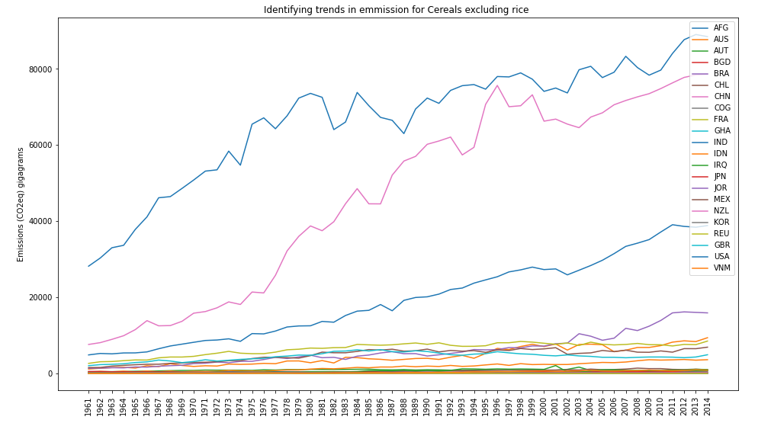
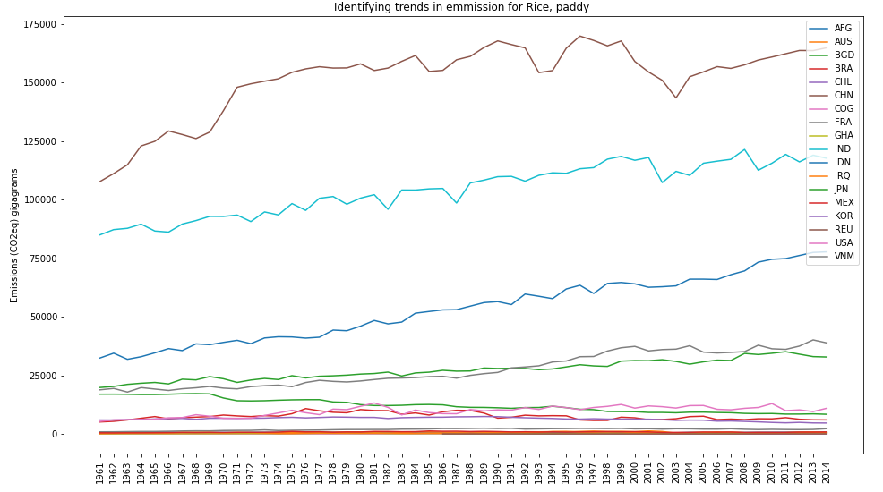
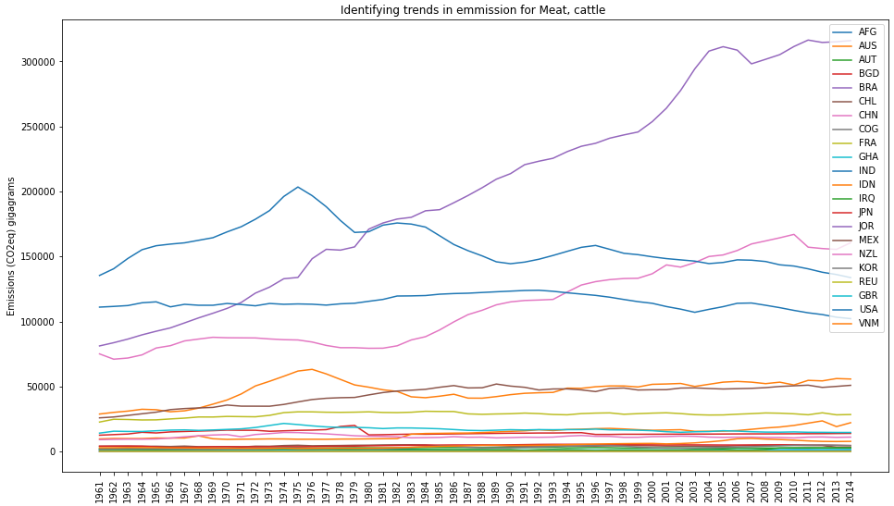
Identifying trends in emission for a limited set of products across various countries

Slide 9
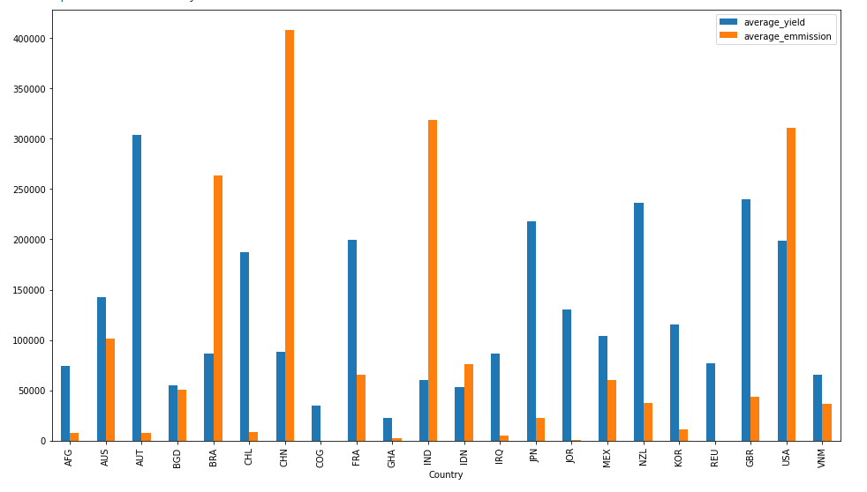
YIELD VS EMMISSION ACROSS COUNTRIES

Slide 10
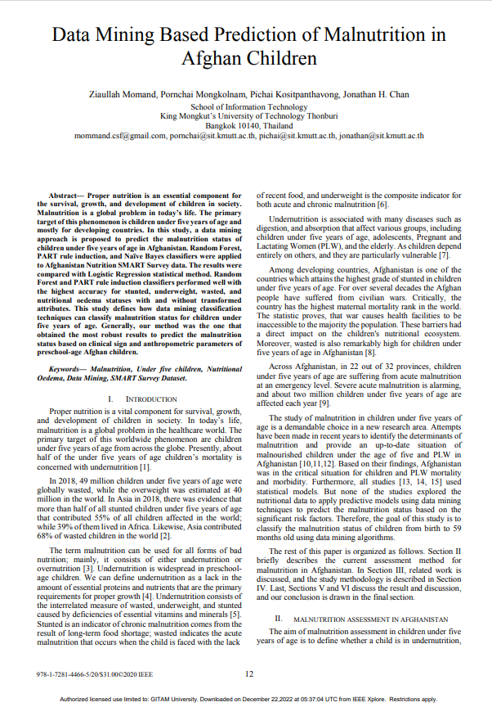
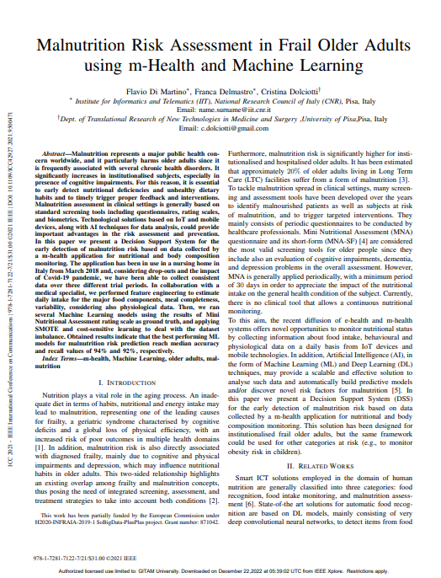
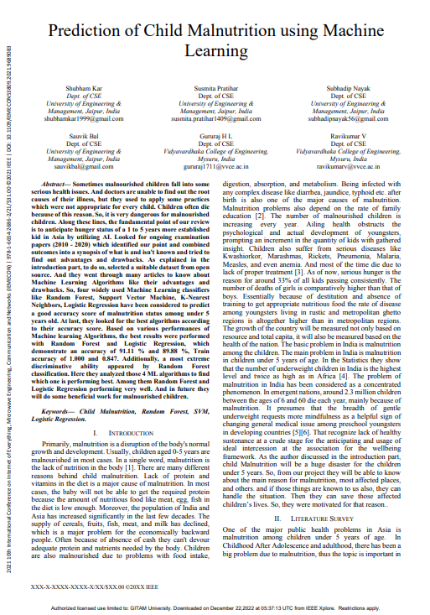

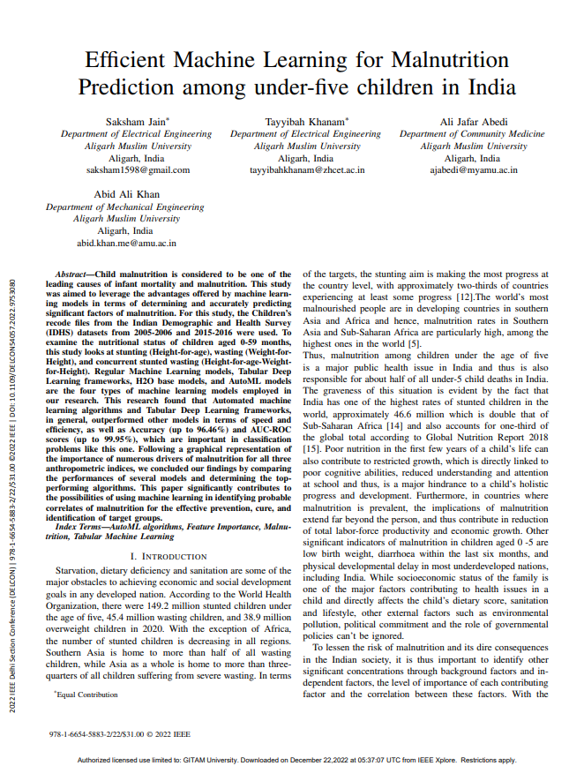
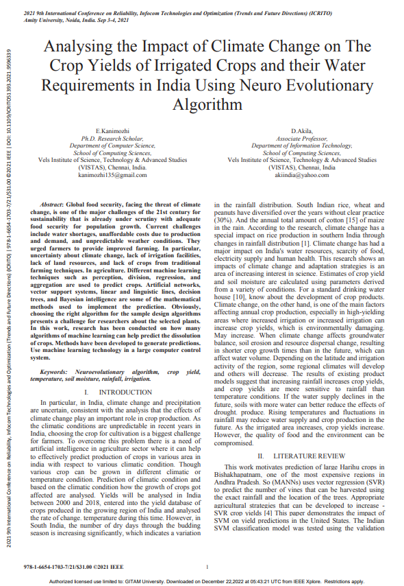
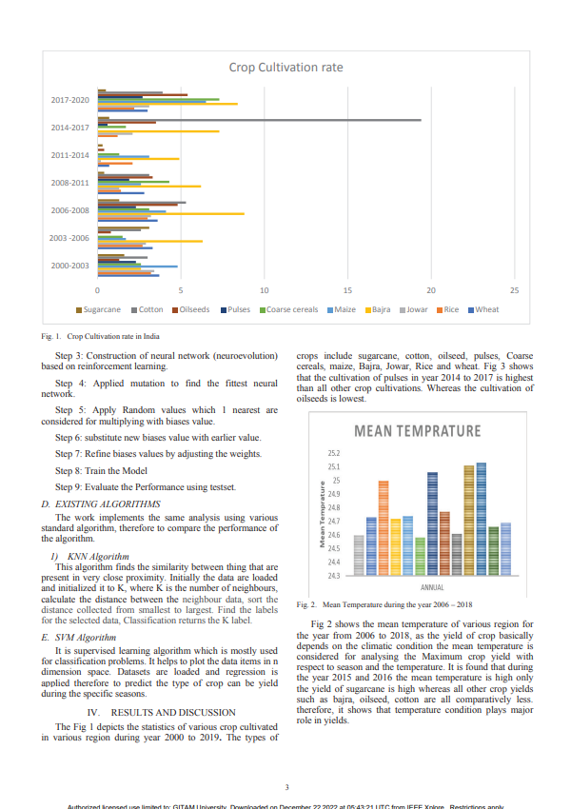
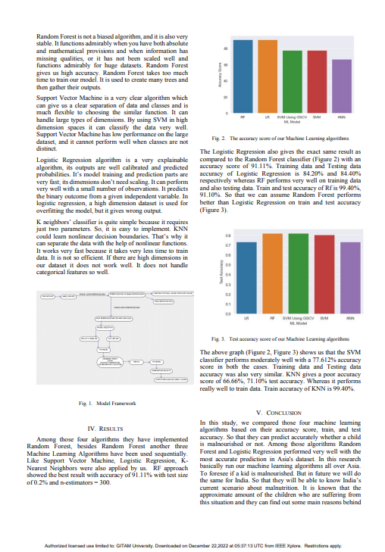

Slide 11
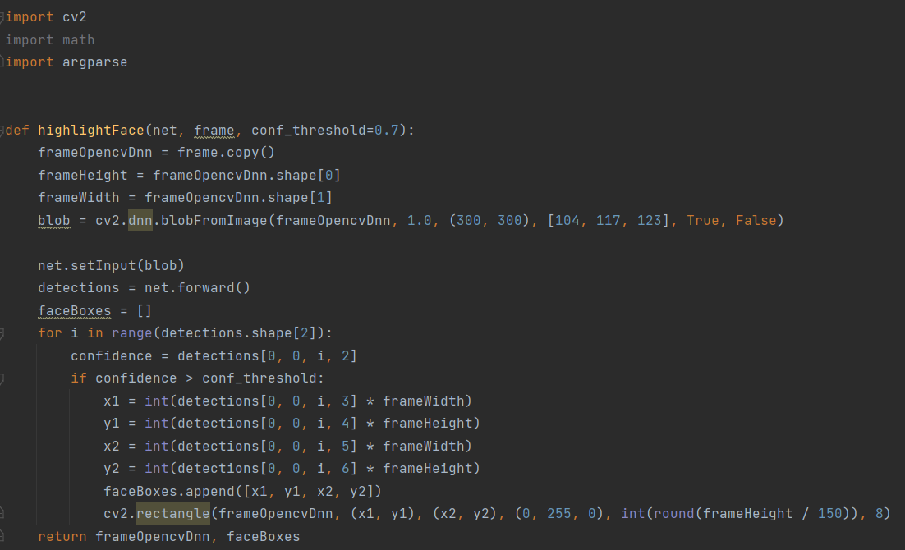
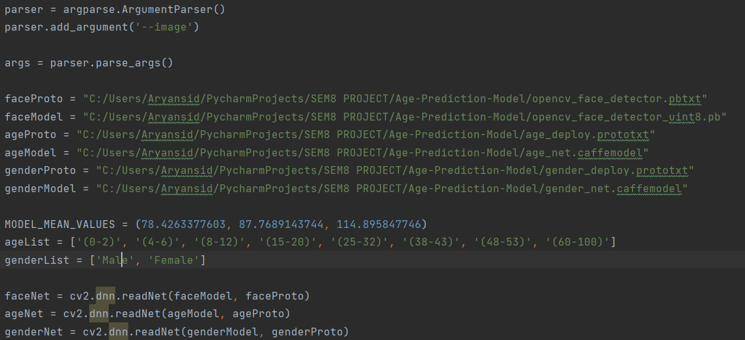
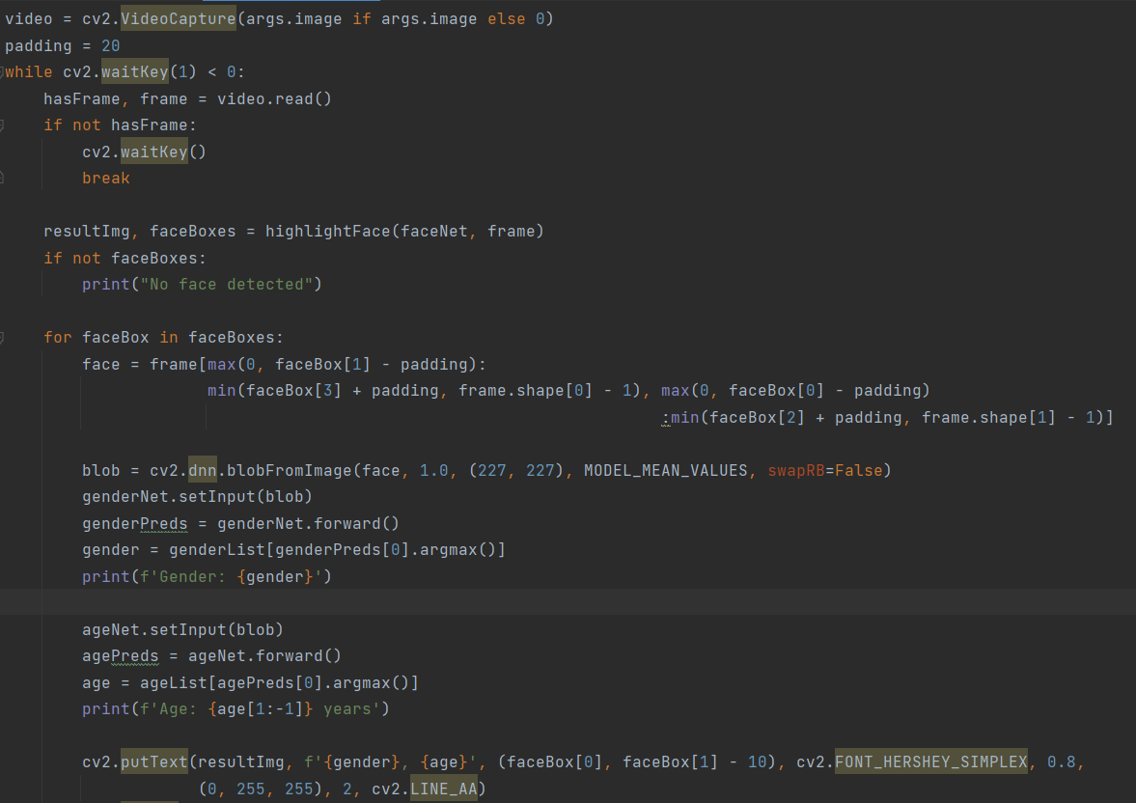
CODE
SNIPPETS
AGE- PREDICTION MODEL USING COMPUTER VISION(OPENCV)

Slide 12
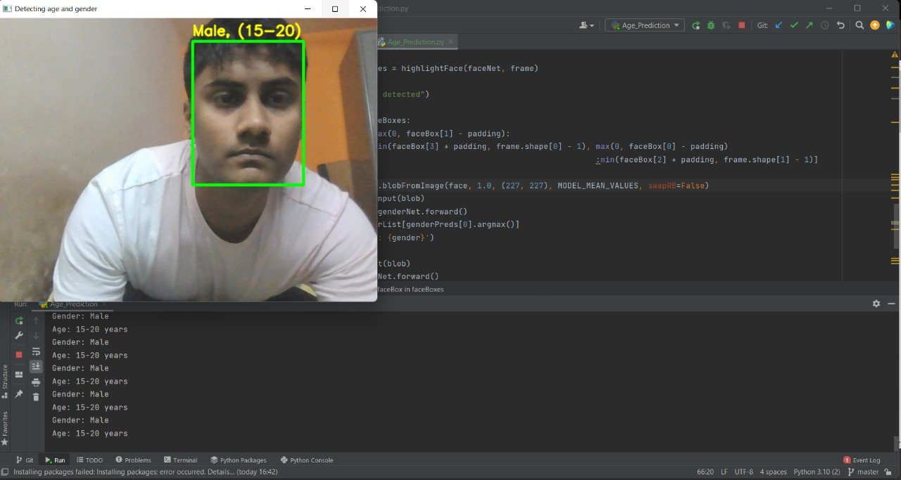
RESULT
This output will help us to identify malnutrition among individuals with playing a major role in implying as an input to predict Body Mass Index and also through tentative age difference will bring it as an inference to skin aging and
nutritional consumptional methods

Slide 13
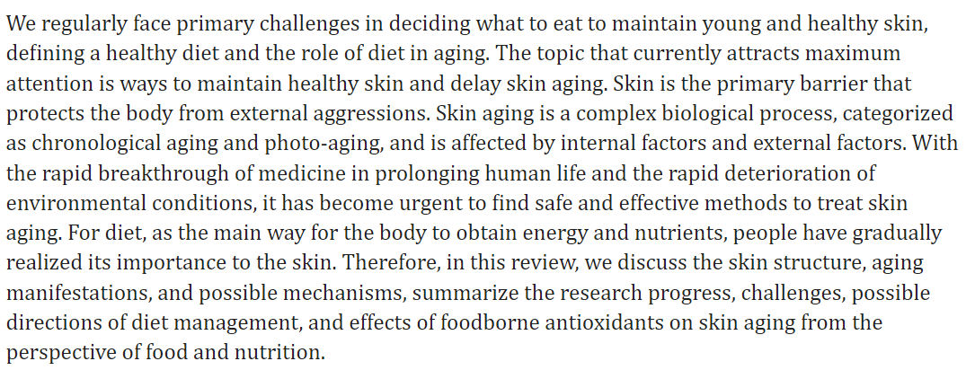
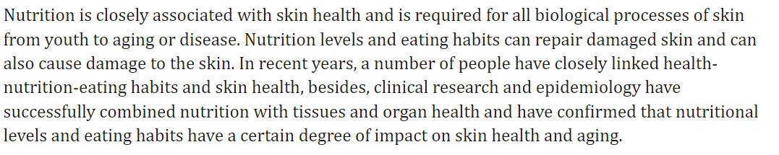
SKIN AGING
The following link is a research based upon the nutritional consumption of individuals impacting their skin age faster due to improper eating habits, this can help us identify humans with imbalanced consumption.
https://www.ncbi.nlm.nih.gov/pmc/articles/PMC7146365/

Slide 14
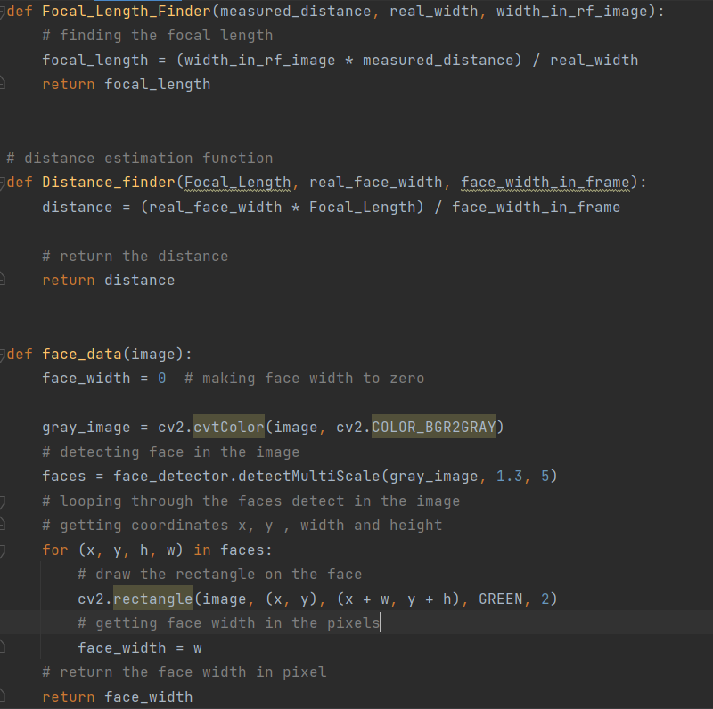
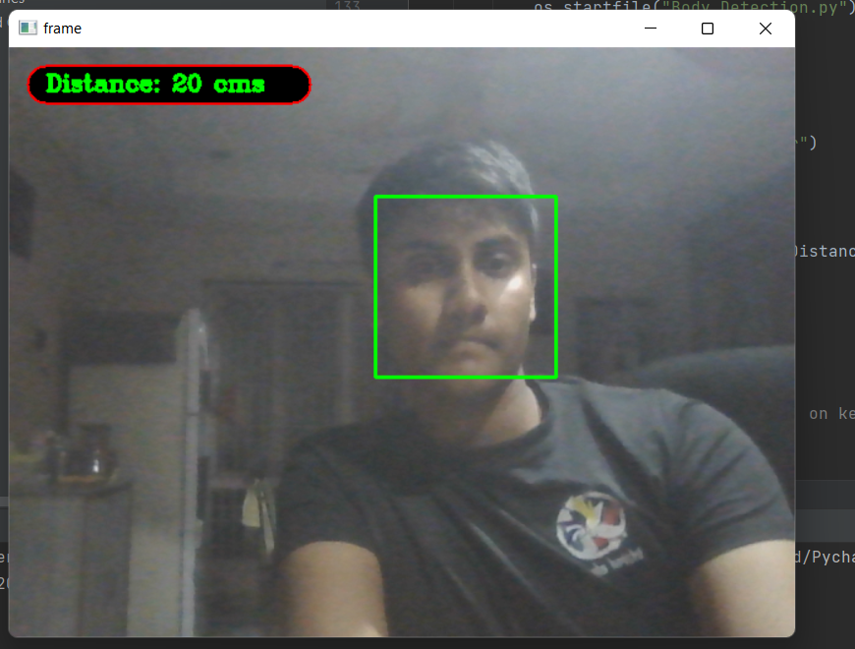
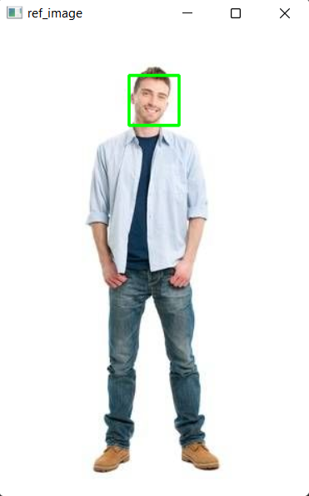
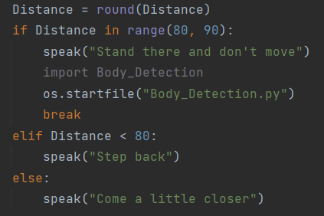
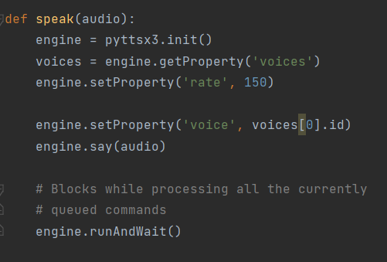
FACE RECOGNITION AND DISTANCE FROM LAPTOP CAMERA
HEIGHT- PREDICTION MODEL USING COMPUTER VISION(OPENCV)

Slide 15
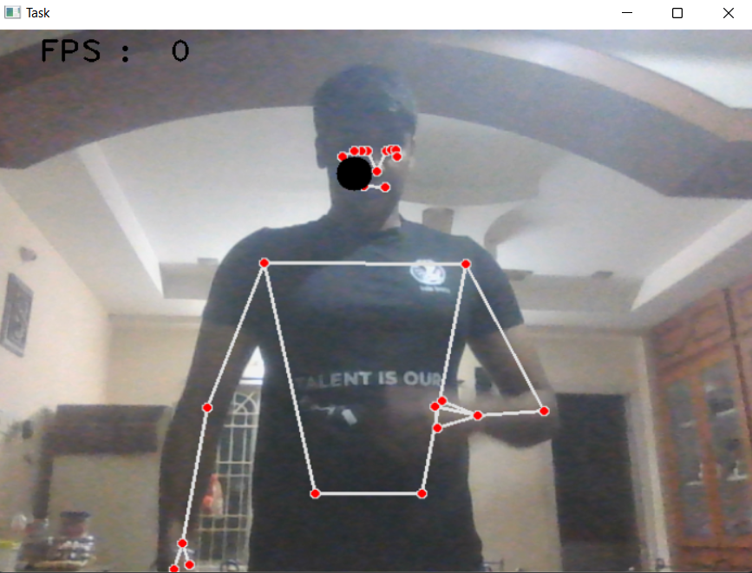
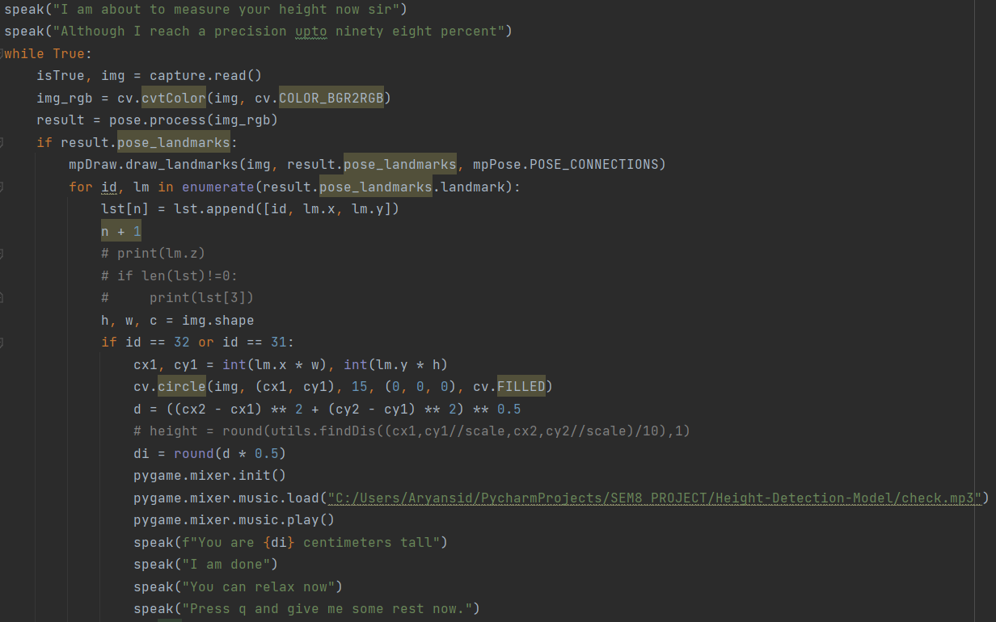
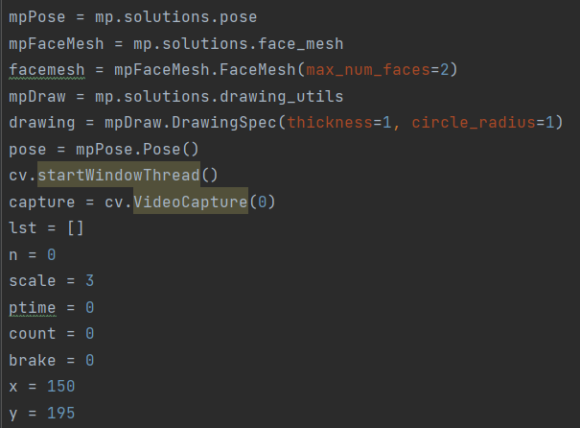
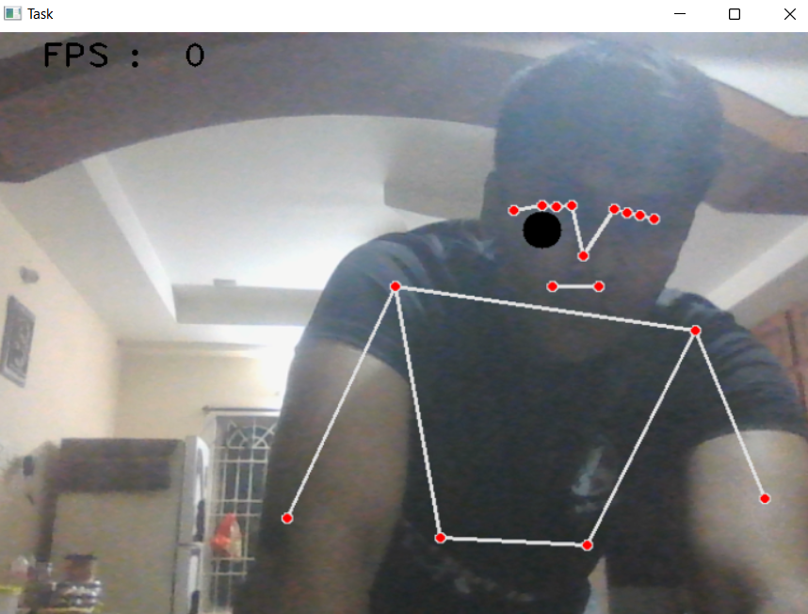
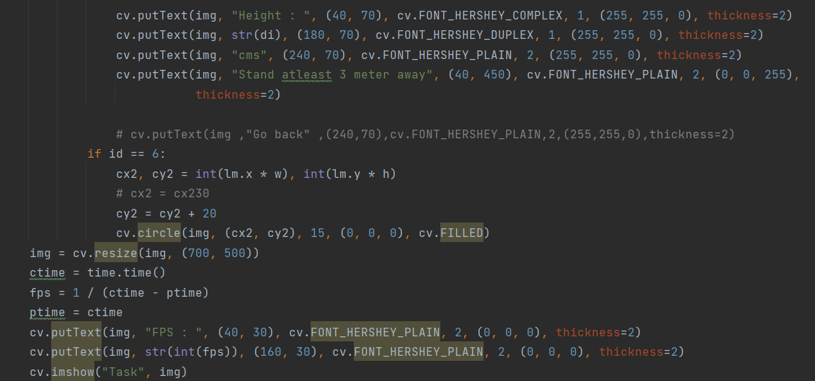
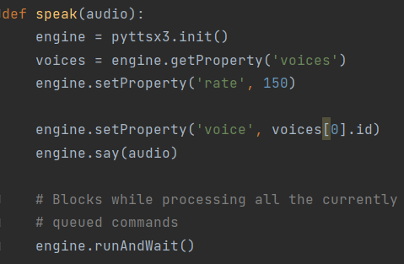
HEIGHT- PREDICTION MODEL USING COMPUTER VISION(OPENCV)
For Detecting Body and Predicting Height
The result for height detection is based upon the positioning of the camera parallelly and distance, this result is obtained through the audio

Slide 16


What is a Haar cascade classifier?
Haar cascade is an algorithm that can detect objects in images, irrespective of their scale in image and location. This algorithm is not so complex and can run in real-time. We can train a haar-cascade detector to detect various objects like cars, bikes, buildings, fruits, etc.
It is an Object Detection Algorithm used to identify faces in an image or a real time video. The algorithm is given a lot of positive images consisting of faces, and a lot of negative images not consisting of any face to train on them.
What is pyttsx3?
pyttsx3 is a text-to-speech conversion library in Python. Unlike alternative libraries, it works offline and is compatible with both Python 2 and 3. An application invokes the pyttsx3.init() factory function to get a reference to a pyttsx3. Engine instance. it is a very easy to use tool which converts the entered text into speech. The pyttsx3 module supports two voices first is female and the second is male which is provided by “sapi5” for windows. It supports three TTS engines :
sapi5 – SAPI5 on Windows
nsss – NSSpeechSynthesizer on Mac OS X
espeak – eSpeak on every other platform

Slide 17
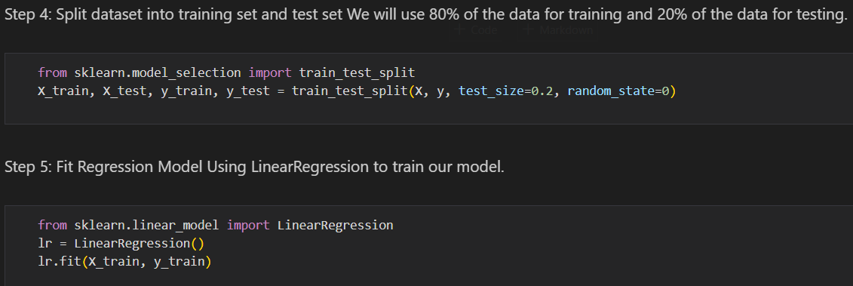
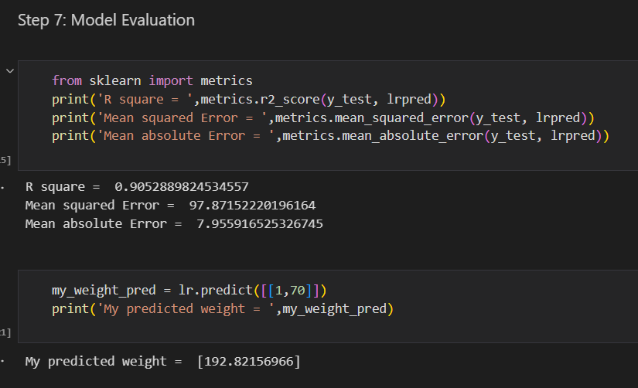
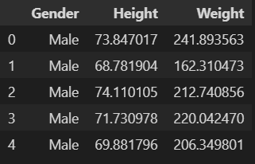
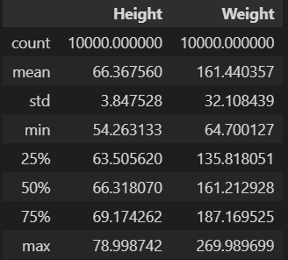

WEIGHT PREDICTION USING HEIGHTS OBTAINED FROM COMPUTER VISION(OPENCV)
Linear Regression is a machine learning algorithm based on supervised learning. It performs a regression task. Regression models a target prediction value based on independent variables. It is mostly used for finding out the relationship between variables and forecasting.

Slide 18




BMI PREDICTION MODEL

Slide 19






Slide 20


BMI PREDICTION MODEL
RESULTS

